Slide 1
Bidirectional Typing
Introduction and adaptation for MLscript

Slide 2

What is it?
One syntax directed way to write typing rules
Uses both type checking and inference
Type checking: when both the term and the expected type are inputs
Type inference: when only the term is the input

Slide 3
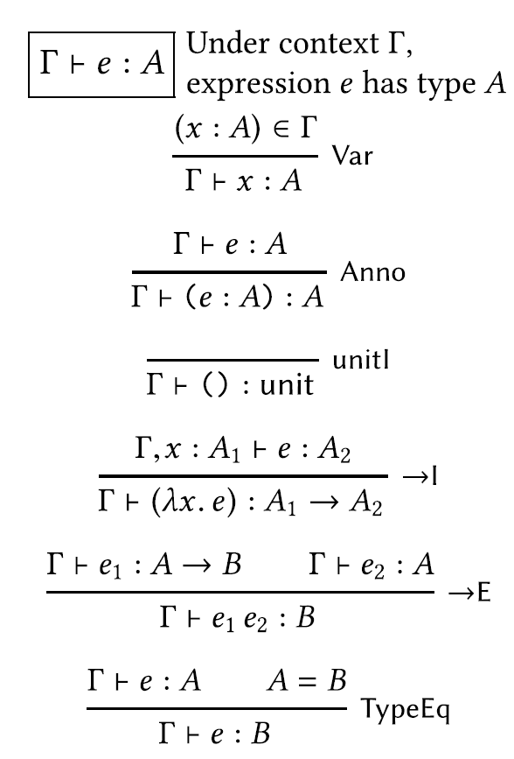
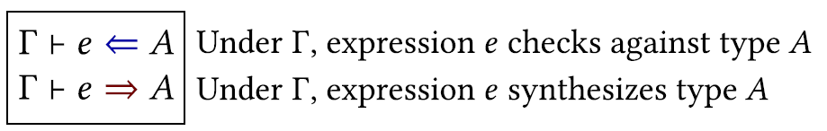

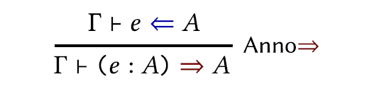
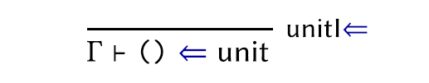
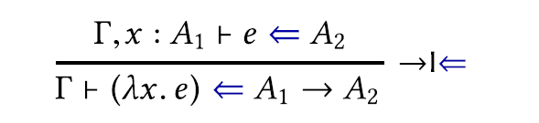
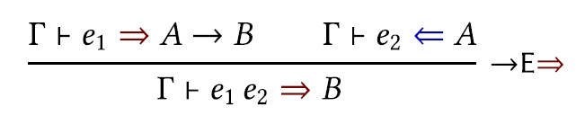
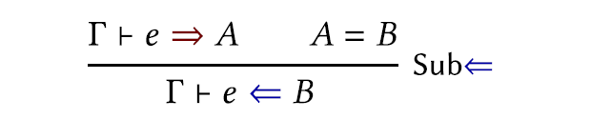
Example with STLC

Slide 4

Why is it useful?
Syntax Directed
More precise reporting of error
Easier to adapt for advanced features
GADT
First class polymorphism

Slide 5
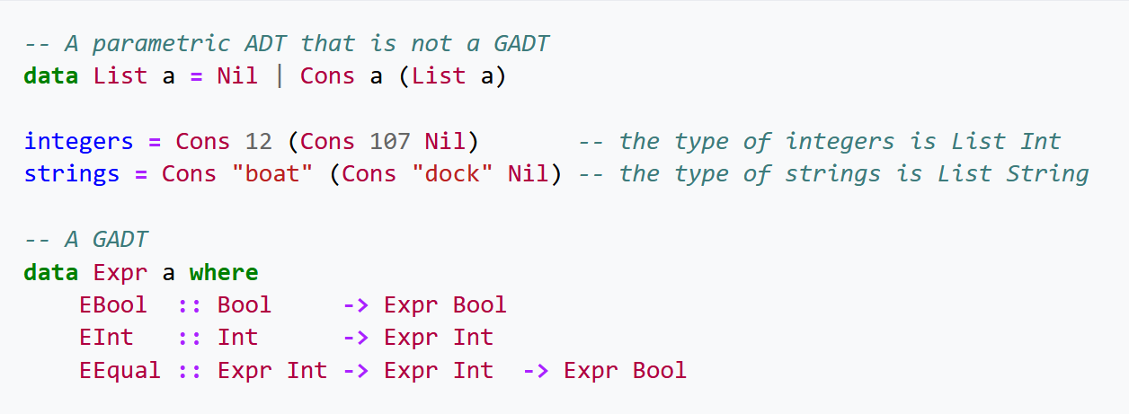
GADT
Generalization of parametric ADT
Constructors can provide an explicit instantiation of the ADT

Slide 6
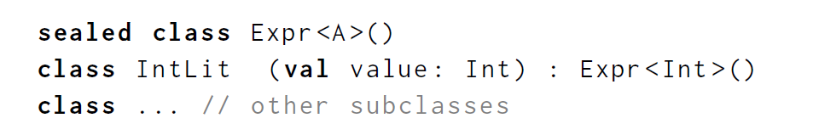
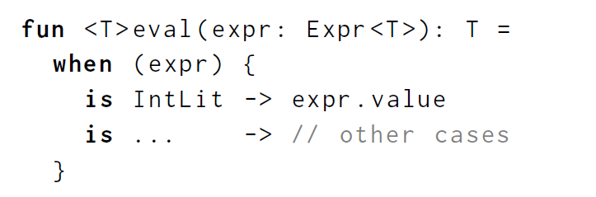
Use in GADT: one example

Slide 7
Elements of Bidirectional Typing
Mode Correctness
Completeness
Size
Annotation Character

Slide 8
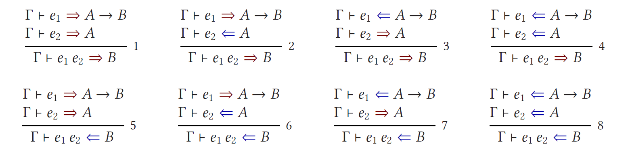

Slide 9
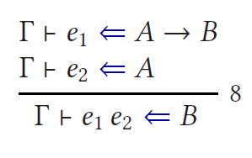
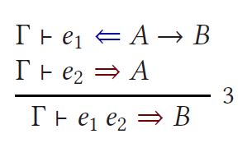
Anything wrong with these rules?

Slide 10
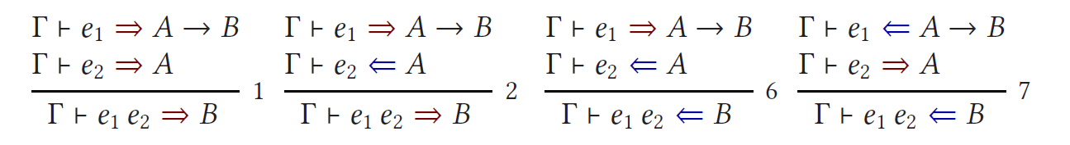
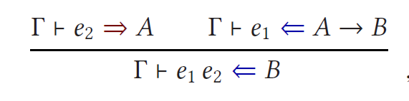
Mode Correctness

Slide 11
Elements of Bidirectional Typing
Mode Correctness
Completeness
Size
Annotation Character

Slide 12
Elements of Bidirectional Typing
Mode Correctness
Completeness
Size
Annotation Character

Slide 13

Annotation Character
Lightweight: small portion of the program
Predictable: Programmers should be able to determine which subterms need annotation.
Stable: Small change in program should have small change in annotation requirement
Legible: form should be easy to understand

Slide 14
Pfenning Recipe
Introduction and Elimination Rule
Find the principal judgement
The connective that is being introduced/eliminated
Usually, the conclusion for introduction and the first premise for elimination
Bidirectionalize the principal judgement
If the rule is introduction, make the principal judgement checking
If the rule is elimination, make the principal judgement inference
Bidirectionalize the other judgements
For conclusion rule, bidirectionalize the premises first
Utilize known information: if we know the type of a term, it should be checking

Slide 15
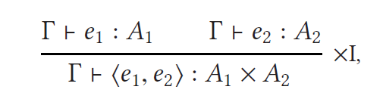
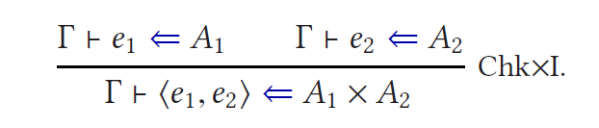
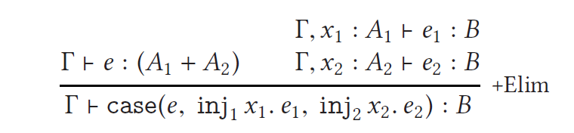
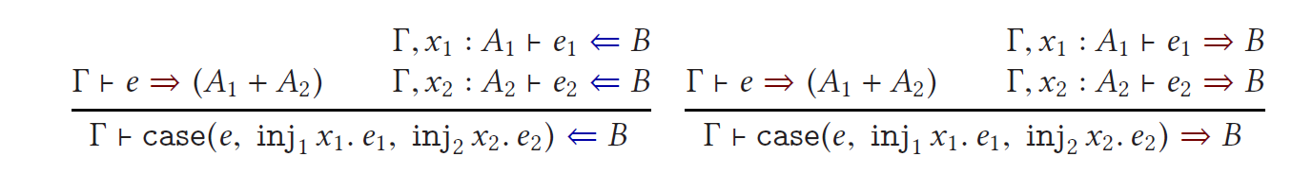
Pfenning Recipe
Introduction and Elimination Rule

Slide 16
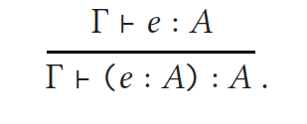
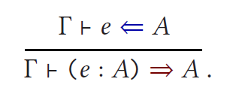
Pfenning Recipe
Annotation: follow the same idea of using known information

Slide 17
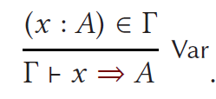
Pfenning Recipe
Variable

Slide 18
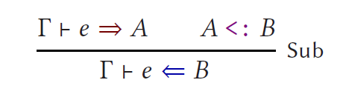
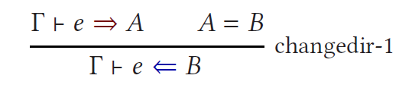
Pfenning Recipe
Change of direction: if we can synthesize a type for a term, we can surely check it against that type

Slide 19

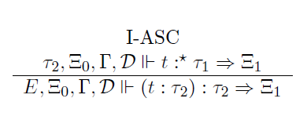
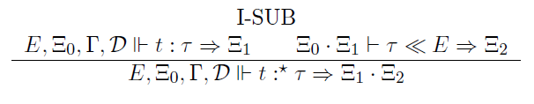
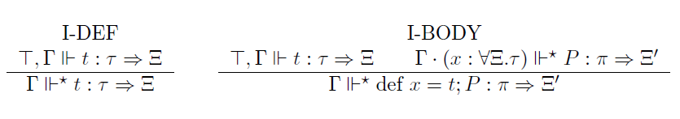
Bidirectional Typing Rules for MLstruct

Slide 20
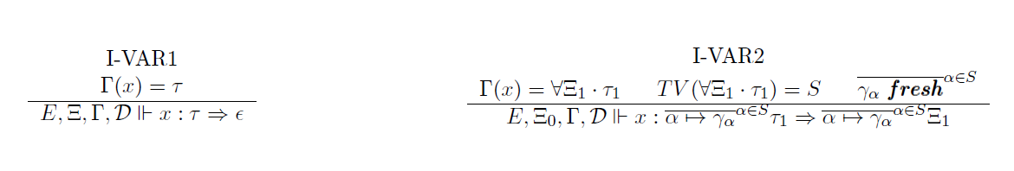
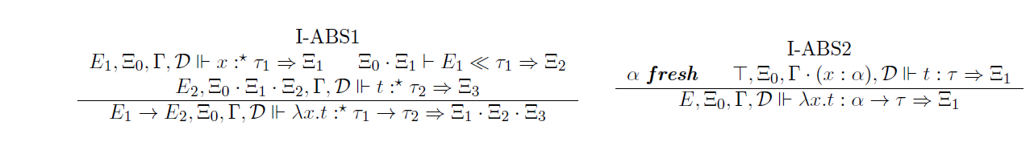
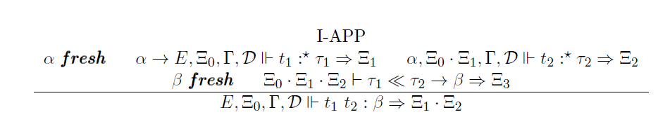
Bidirectional Typing Rules for MLstruct

Slide 21
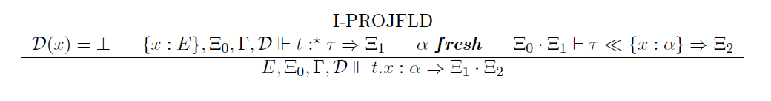
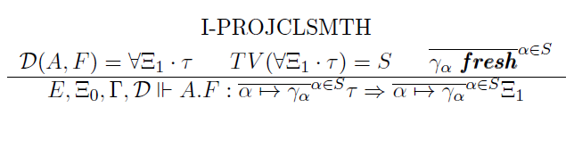
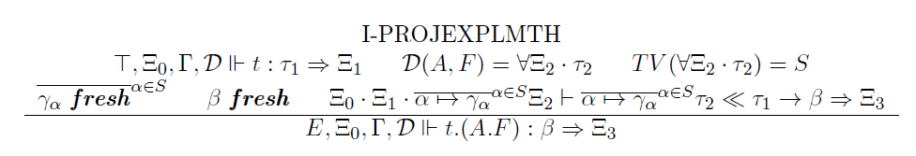
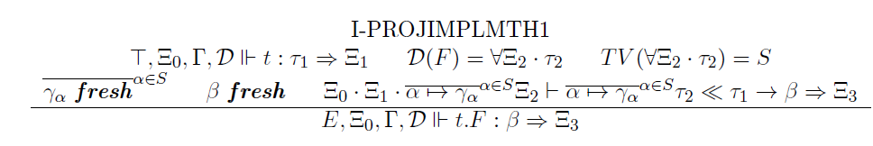
Bidirectional Typing Rules for MLstruct

Slide 22
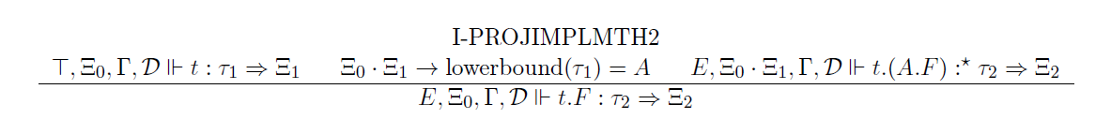

Bidirectional Typing Rules for MLstruct

Slide 23
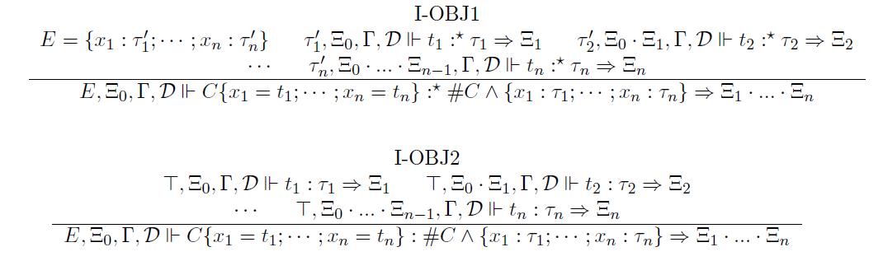
Bidirectional Typing Rules for MLstruct

Slide 24
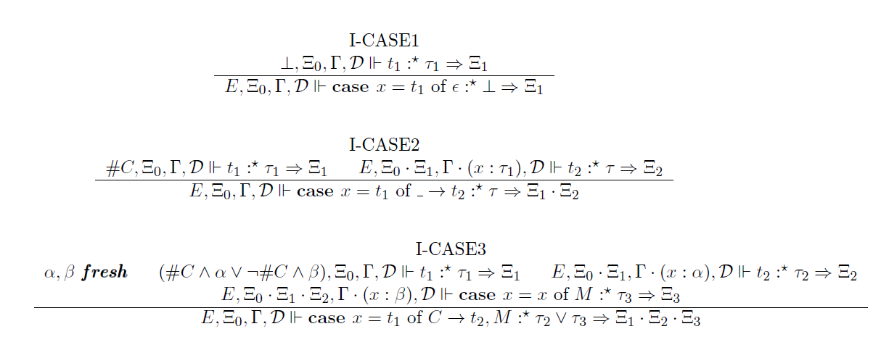
Bidirectional Typing Rules for MLstruct

Slide 25
References
Jana Dunfield and Neel Krishnaswami. 2021. Bidirectional Typing. ACM Comput. Surv. 54, 5, Article 98 (June 2022), 38 pages. https://doi.org/10.1145/3450952
Lionel Parreaux and Chun Yin Chau. 2022. MLstruct: principal type inference in a Boolean algebra of structural types. Proc. ACM Program. Lang. 6, OOPSLA2, Article 141 (October 2022), 30 pages. https://doi.org/10.1145/3563304
Aleksander Boruch-Gruszecki, Radosław Waśko, Yichen Xu, and Lionel Parreaux. 2022. A case for DOT: theoretical foundations for objects with pattern matching and GADT-style reasoning. Proc. ACM Program. Lang. 6, OOPSLA2, Article 179 (October 2022), 30 pages. https://doi.org/10.1145/3563342

Slide 26
Q&A

